Slide 1
QNLP Workflow on HPC + QC
QCE23 Tutorial – 09/21/2023
In-Saeng Suh, Prasanna Date, Francisco Rios, Antonio Coello Perez, Kathleen Hamilton, Mayanka Chandra Shekar, John Gounley and Georgia Tourassi
Oak Ridge National Laboratory
This research is supported by the Department of Energy Office of Science Advanced Scientific Computing Research program office.

Slide 2
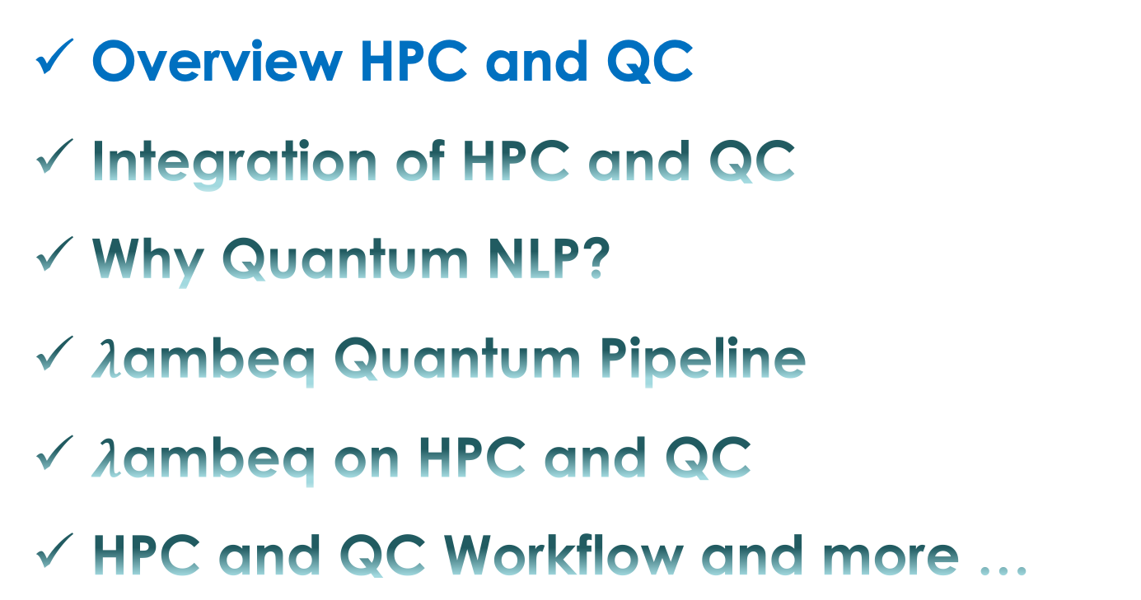
Contents
Overview HPC and QC
Integration of HPC and QC
Why Quantum NLP?
$λ$ambeq Quantum Pipeline
$λ$ambeq on HPC and QC
HPC and QC Workflow and more …

Slide 3

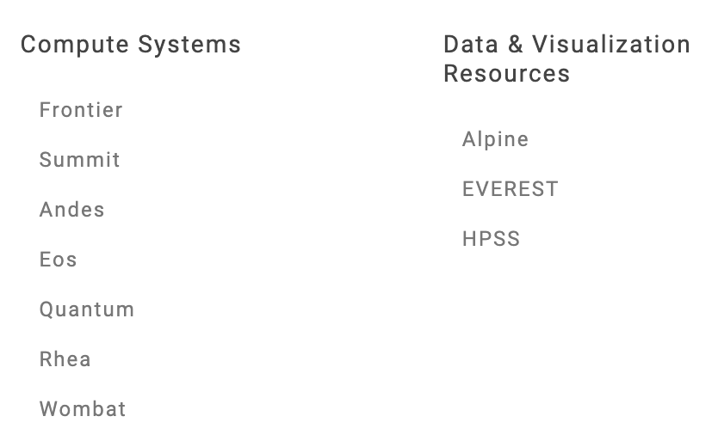
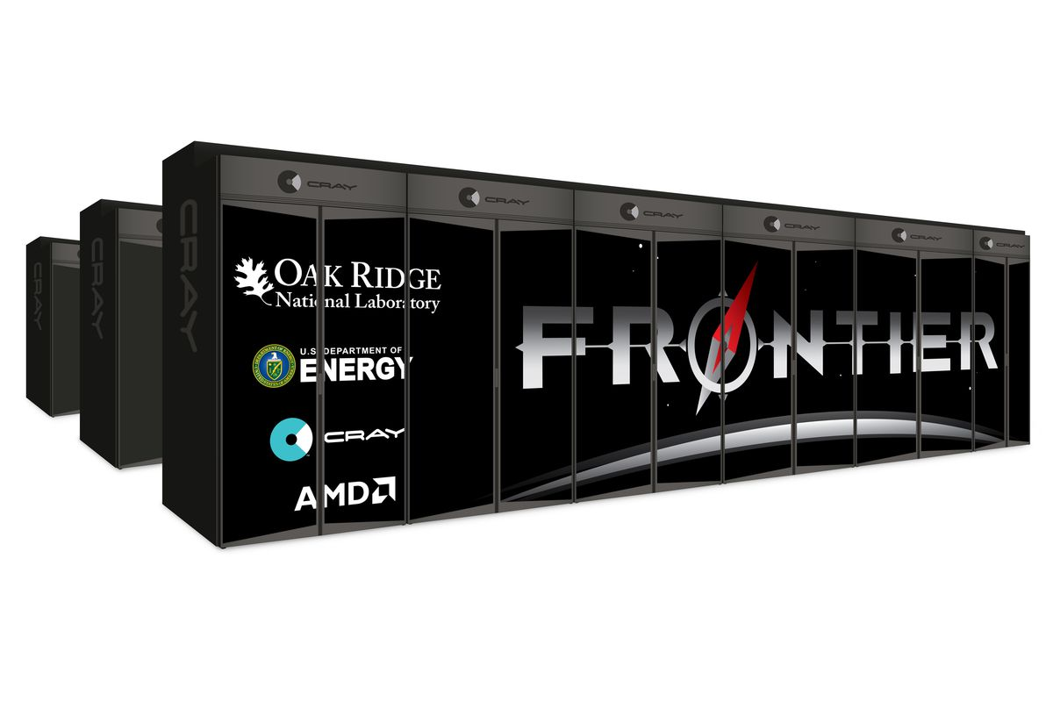
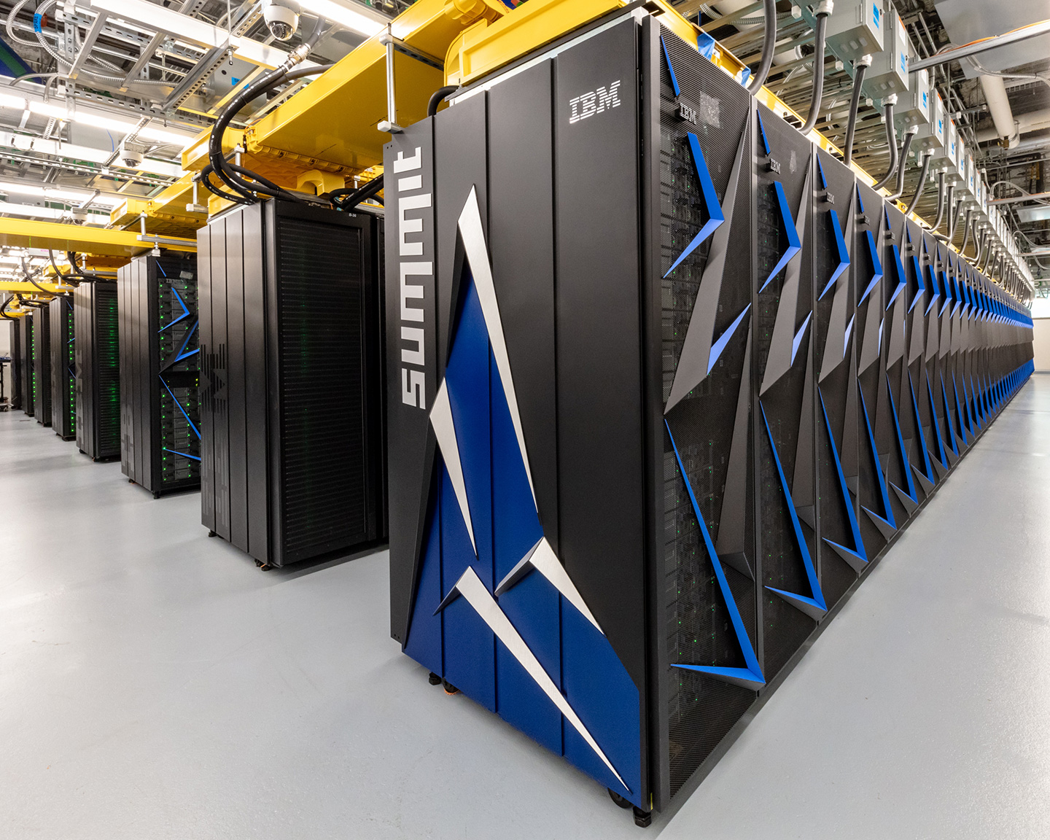
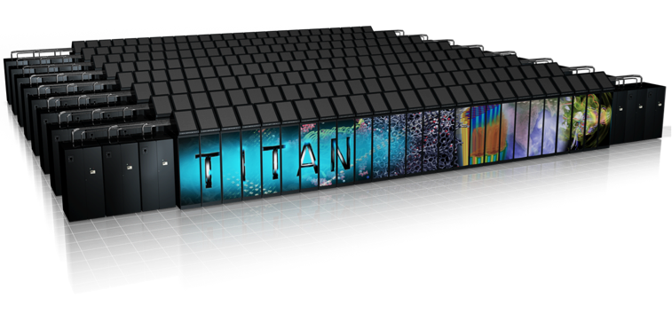
Cray XK7, 18,688 Nodes
16-core AMD Interlagos + K20X
17 PFLOPS, 8.2 MW,
#1 TOP500 (2012)
HPE CRAY EX, 9,472 Nodes
1 AMD EPYC + 4 Radeon Instinct
1.194 ExaFLOPS, 21.1 MW
#1 Top500 2022 - 2023
IBM, 4,600 Nodes
2 Power9 + 6 NVidia Volta
144 PFLOPS, 9.7 MW,
#1 TOP500 (2018)

Slide 4
Notes:
2020 DOE INCITE Allocations by Category
Computing for scientific and engineering problems and the science of doing such computations
Modelling challenges generate new computer requirements, while computer constraints spur new methods for simulation
Example: Monte Carlo sampling using GPU-accelerated compute nodes

Slide 5
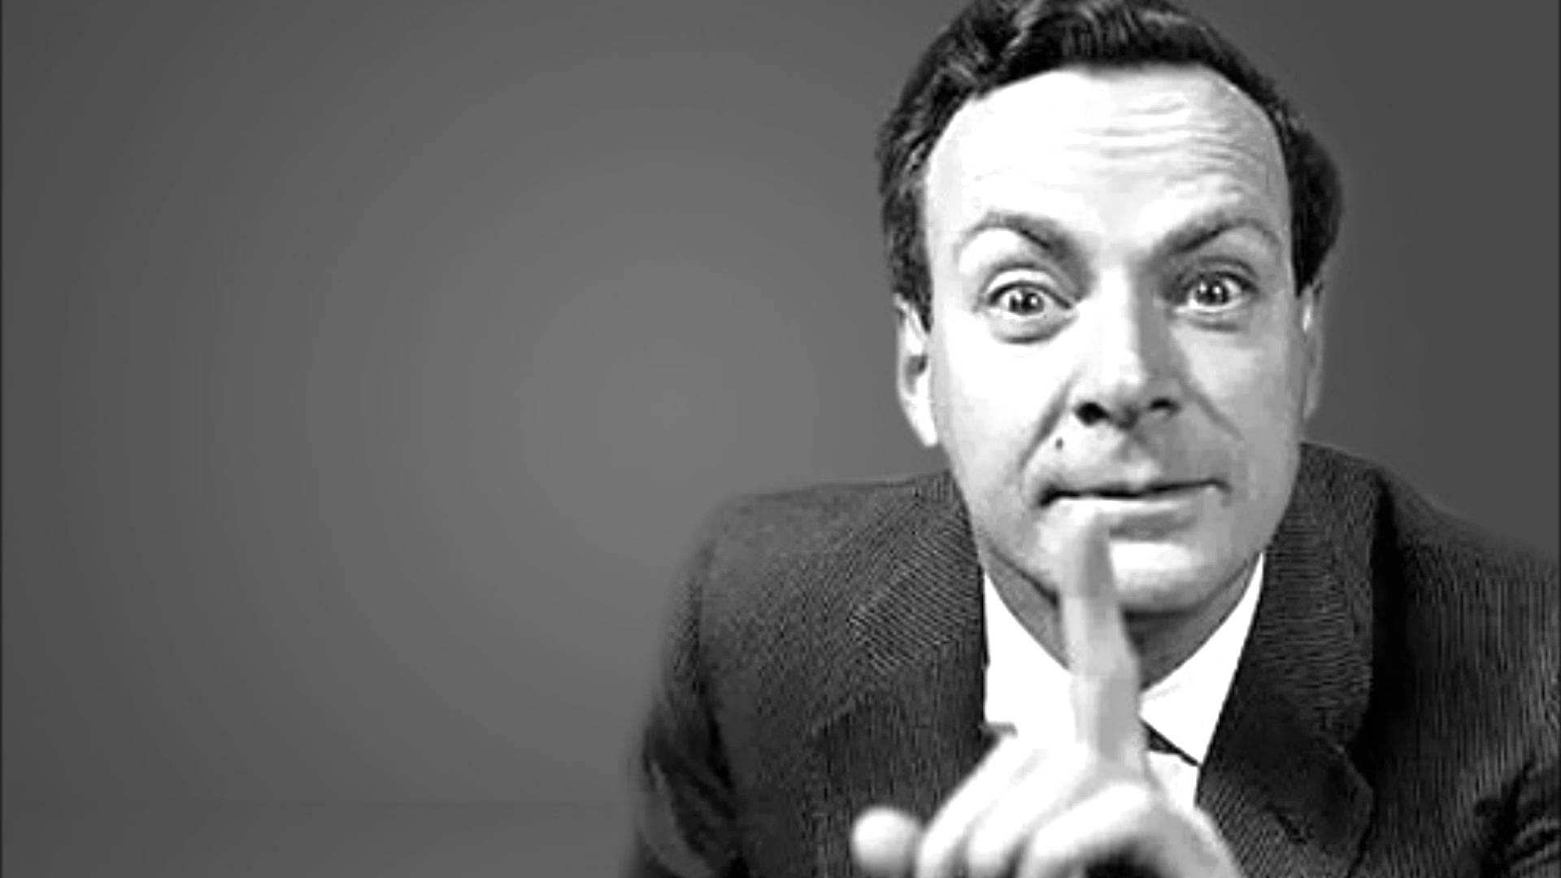
“If you want to make a simulation of nature, you'd better make it quantum mechanical, and by golly it’s a wonderful problem, because it doesn't look so easy.” Richard Feynman, Simulating Physics with Computers May 1981
Notes:
Feynman emphasizes that computing with the laws of quantum physics could open up new territory, but that it would be a challenging capability to master

Slide 6
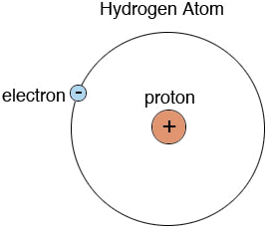
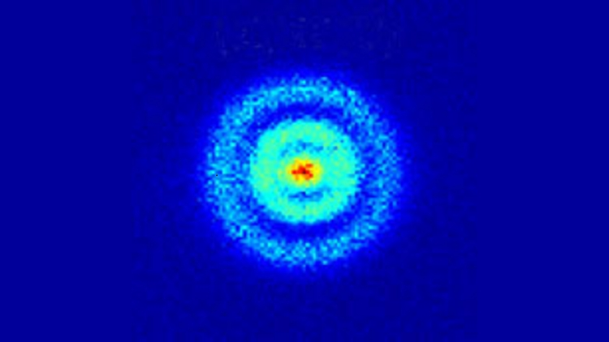

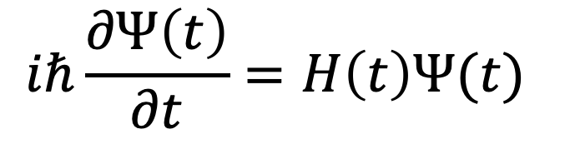
What is Quantum Computing?
Quantum mechanical computation
In quantum mechanics, the wave function describes all knowledge about the system
Quantum computing manipulates the wave function to perform calculations
Quantum dynamical control of the Hamiltonian corresponds to computation
$$iℏ\frac{∂Ψ\left(t\right)}{∂t}=H\left(t\right)Ψ(t)$$
➔$Superposion and Entanglement$
Stodolna et al. PRL 110, 213001 (2013)
Notes:
Hydrogen Atoms under Magnification: Direct Observation of the Nodal Structure of Stark States
In this Letter, we report photoionization microscopy experiments where this nodal structure is directly observed. The experiments provide a validation of theoretical predictions that have been made over the last three decades.

Slide 7
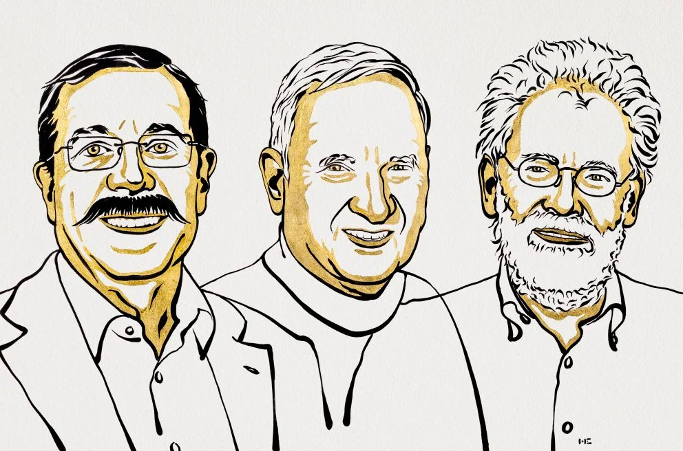
The Nobel Prize in Physics 2022 has been awarded to
Alain Aspect, John F. Clauser and Anton Zeilinger
“for experiments with entangled photons, establishing the violation of Bell inequalities
and pioneering quantum information science.”
Notes:
Feynman emphasizes that computing with the laws of quantum physics could open up new territory, but that it would be a challenging capability to master

Slide 8
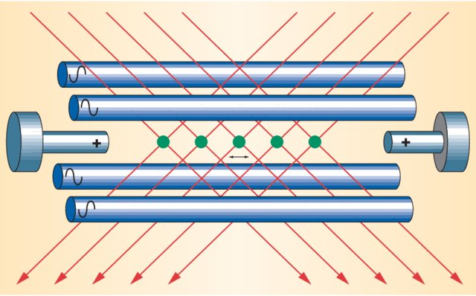
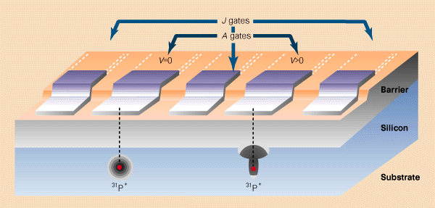
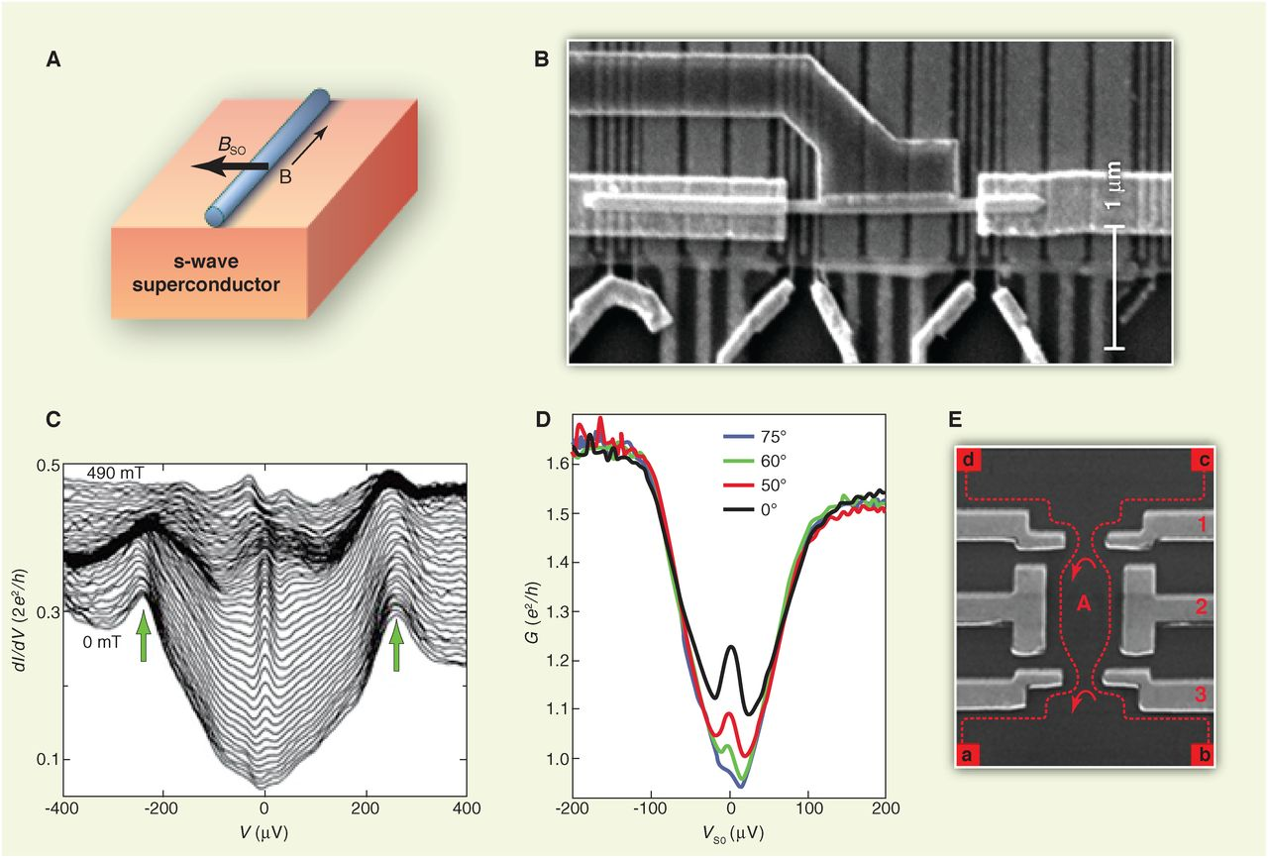
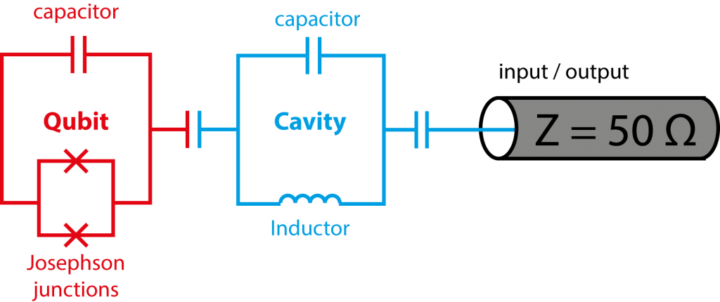
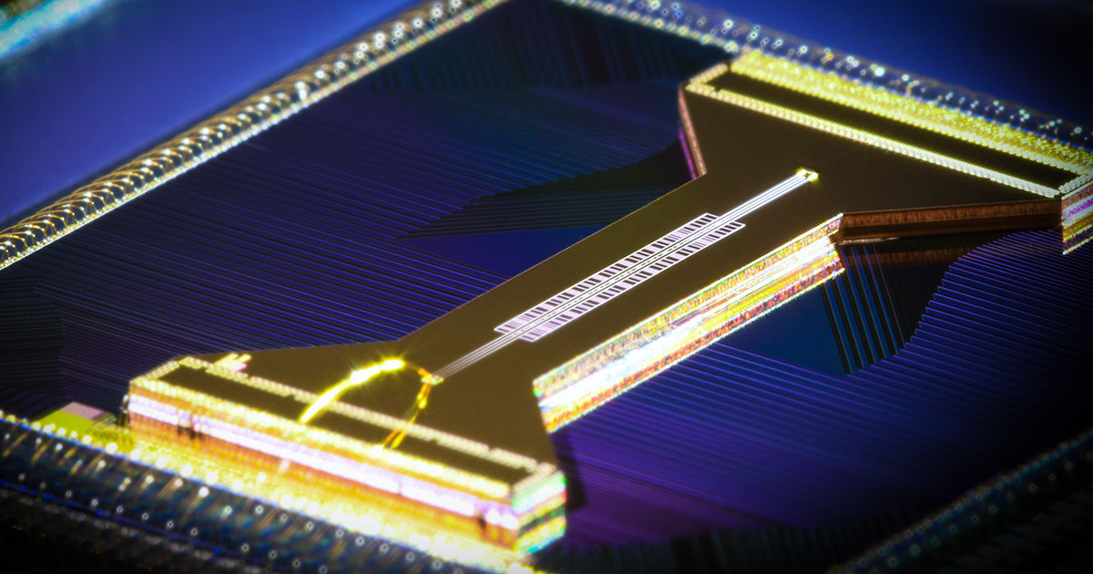
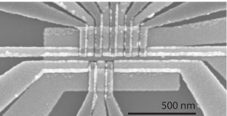
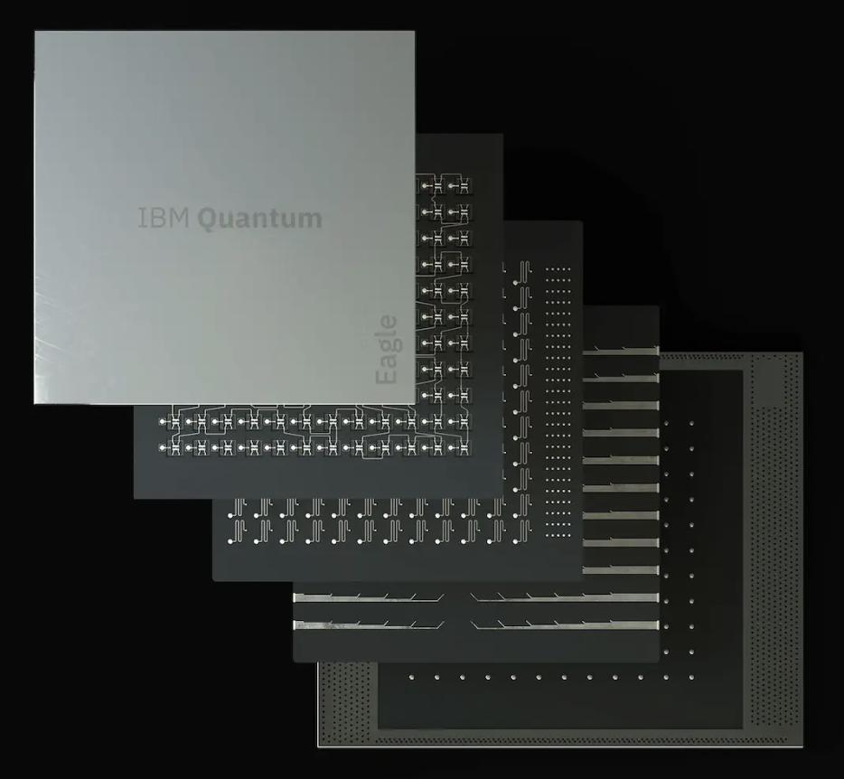
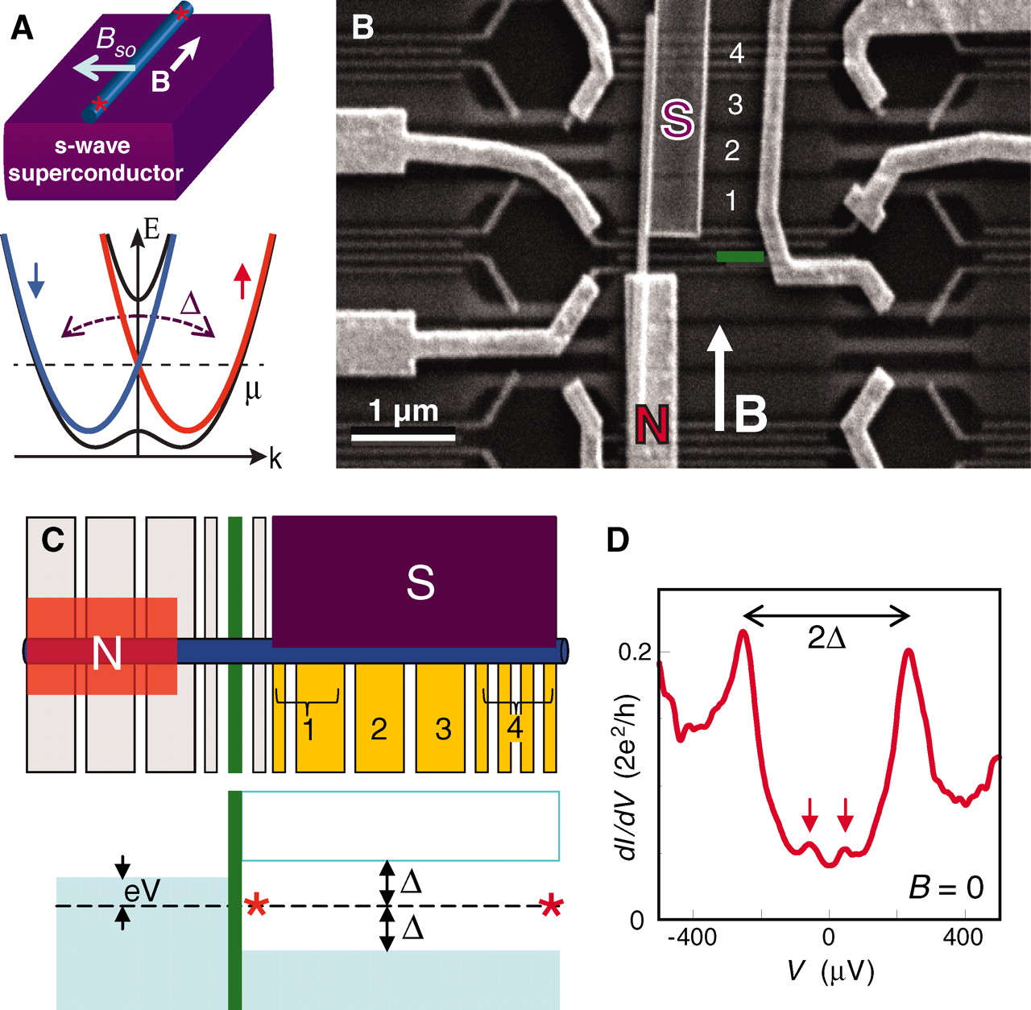
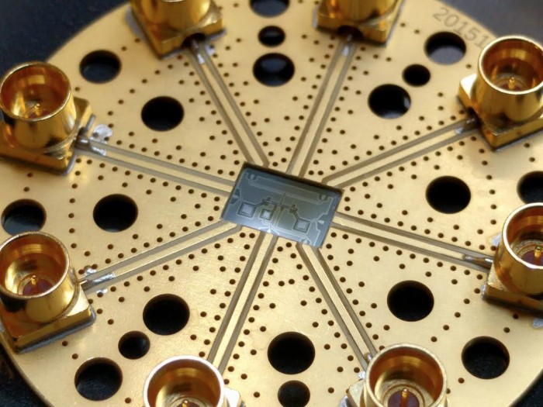
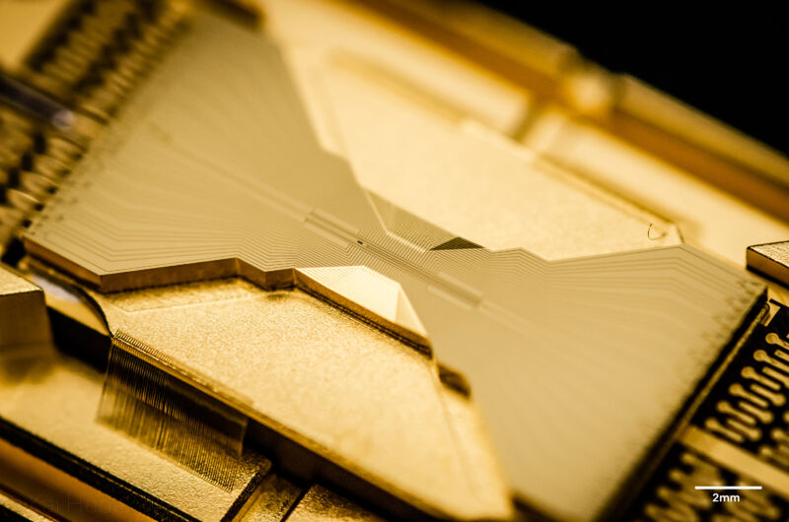
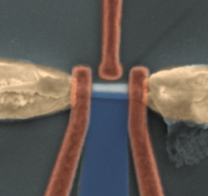
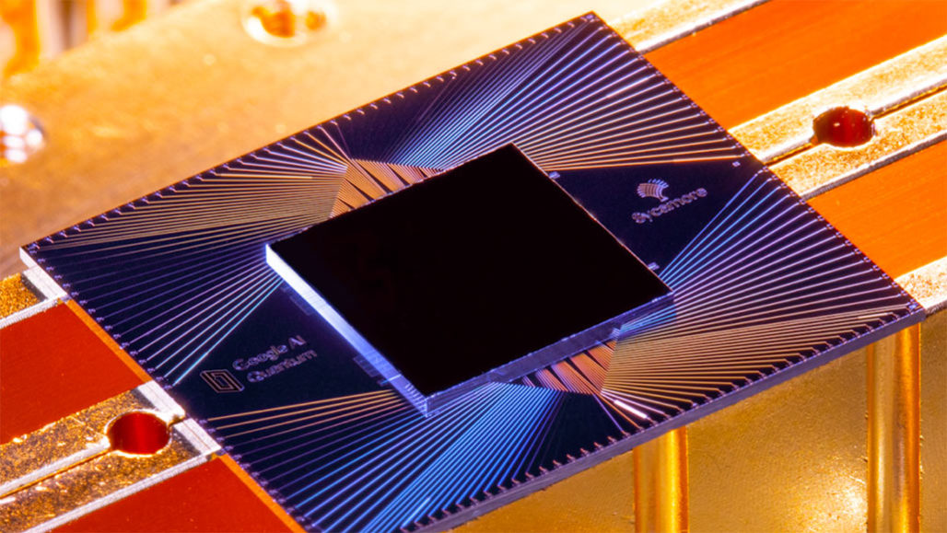
Quantum Devices for Quantum Computing
Atoms & Ions
Semiconductors
Superconductors
Topological Materials
Quantinuum
Intel
Delft
IBM
Rigetti
IonQ
UNSW
Copenhagen
Google
Credit Steane & Rieffel
Credit DiVincenzo
Credit Dickel
Credit Stern & Linder
Notes:
Trapped Ions
A. M. Steane and E. G. Rieffel, "Beyond bits: the future of quantum information processing," in Computer, vol. 33, no. 1, pp. 38-45, Jan. 2000, doi: 10.1109/2.816267.
https://ieeexplore.ieee.org/document/816267
Superconductors
Dickel, https://blog.qutech.nl/2017/08/13/how-to-make-artificial-atoms-out-of-electrical-circuits-part-ii-circuit-quantum-electrodynamics-and-the-transmon/
Semiconductors
D DiVincenzo, Real and realistic quantum computers, Nature volume 393, pages113–114(1998)
https://www.nature.com/articles/30094
Topological materials
Stern and Linder, Topological Quantum Computation—From Basic Concepts to First Experiments
Science 08 Mar 2013: Vol. 339, Issue 6124, pp. 1179-1184 DOI: 10.1126/science.1231473
https://science.sciencemag.org/content/339/6124/1179
V. Mourik et al., Signatures of Majorana Fermions in Hybrid Superconductor-Semiconductor Nanowire Devices, Science (2012); 10.1126/science.1222360
Implemented version of theoretical proposals. Scanning electron microscope image of the device with normal (N) and superconducting (S) contacts. The S contact only covers the right part of the nanowire. The underlying gates, numbered 1 to 4, are covered with a dielectric.
Yu, P. et al. Non-majorana states yield nearly quantized conductance in superconductor-semiconductor nanowire devices, Phys. Rev. B 100, 205412, (2019)

Slide 9
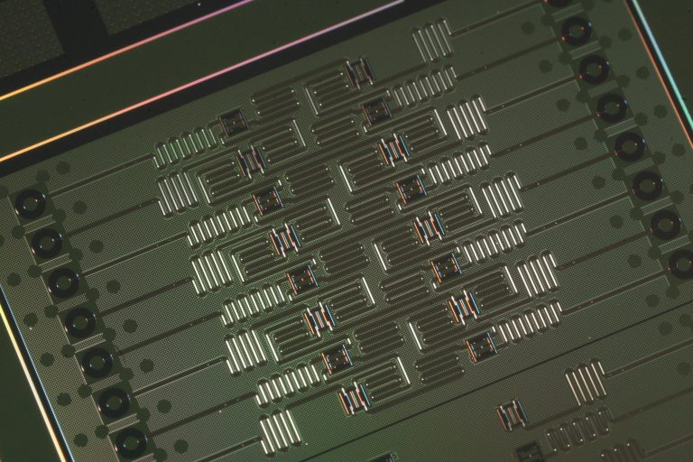
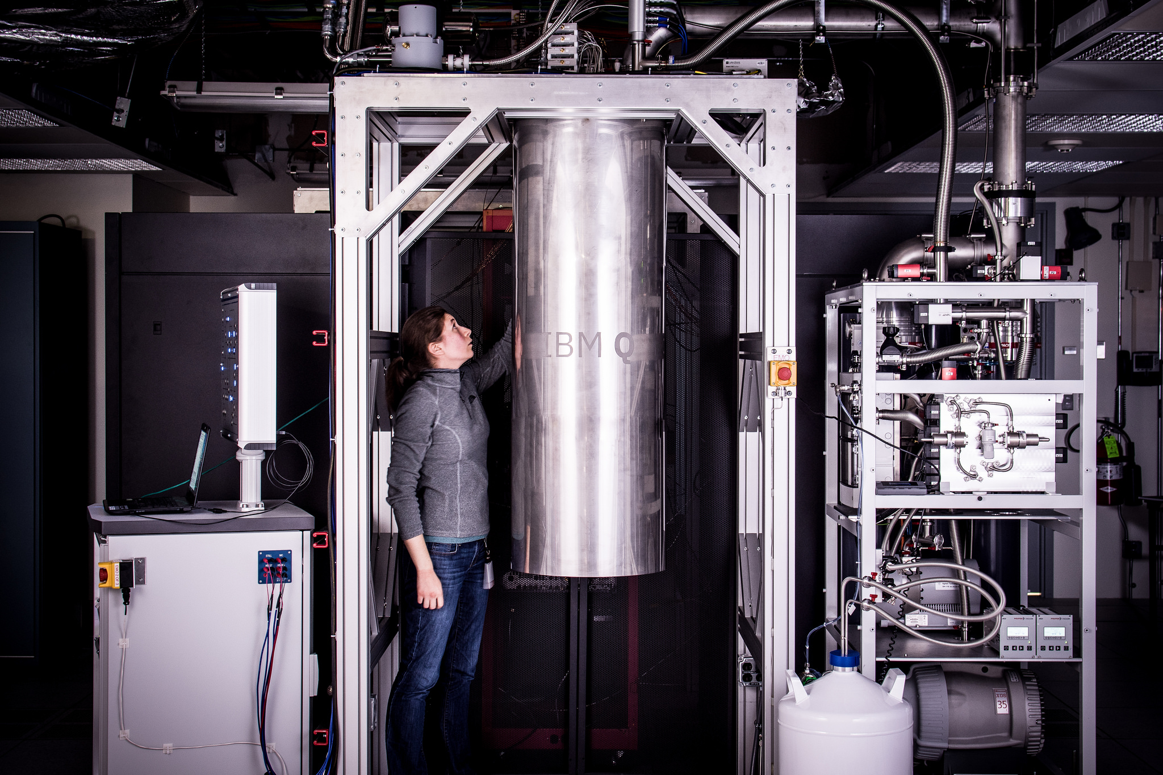
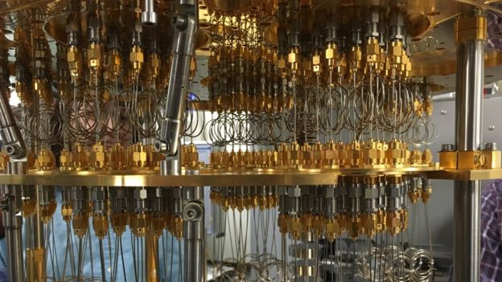
Quantum Processing Units (QPU)
Example: IBM Q processor
Programmable integrated superconducting QPU
Electromagnetic shielding, ultra-high vacuum, cryogenically cooled to ~13mK
27, 65, 127, and 433 (Osprey) qubit register
General-purpose, gate mode
Gate errors <1%, measure errors ~ 5%
Cloud-based access, HTTPS
Authentication and management
Job queuing system
Credit IBM Q 16-qubit processor
Credit IBM Q
Credit IBM Q processor control lines

Slide 10
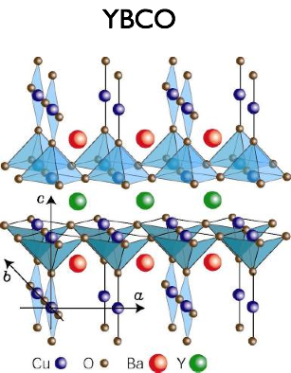
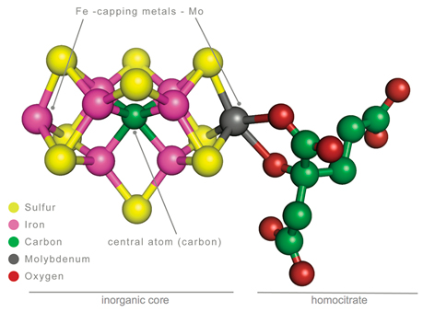
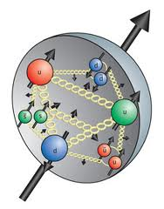
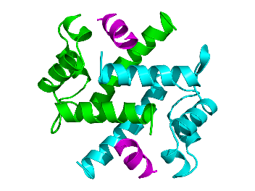
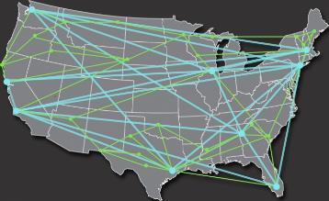
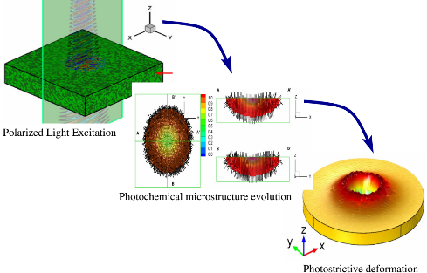
Scientific Computing with Quantum Computers
Algorithms in the quantum computing model have been found to take fewer steps to solve problems
Several physical domains motivate quantum computing as a new paradigm for scientific computing
Quantum Simulation
Partition Functions
Discrete Optimization
Machine Learning
Factoring
Unstructured Search
Eigensystems
Linear Systems
High-energy Physics
Materials Science
Chemistry
Biological Systems
Artificial Intelligence
Data Analytics
Planning and Routing
Verification and Validation

Slide 11
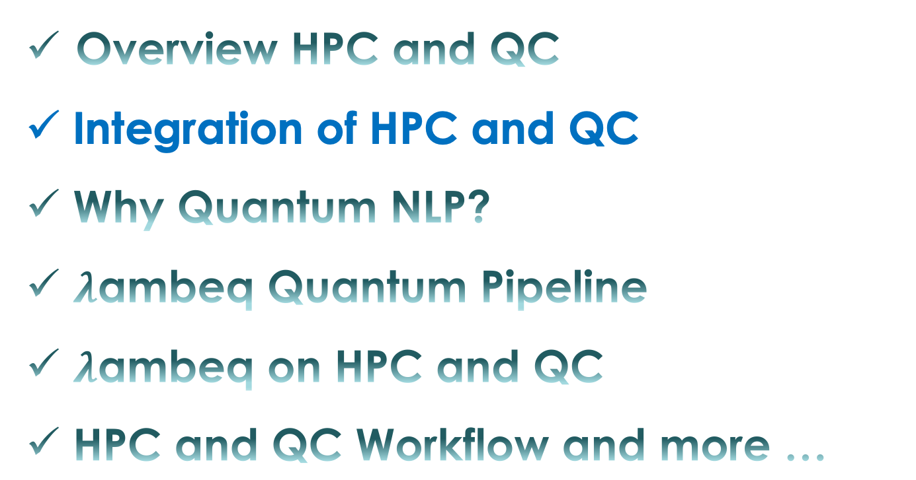
Contents
Overview HPC and QC
Integration of HPC and QC
Why Quantum NLP?
$λ$ambeq Quantum Pipeline
$λ$ambeq on HPC and QC
HPC and QC Workflow and more …

Slide 12
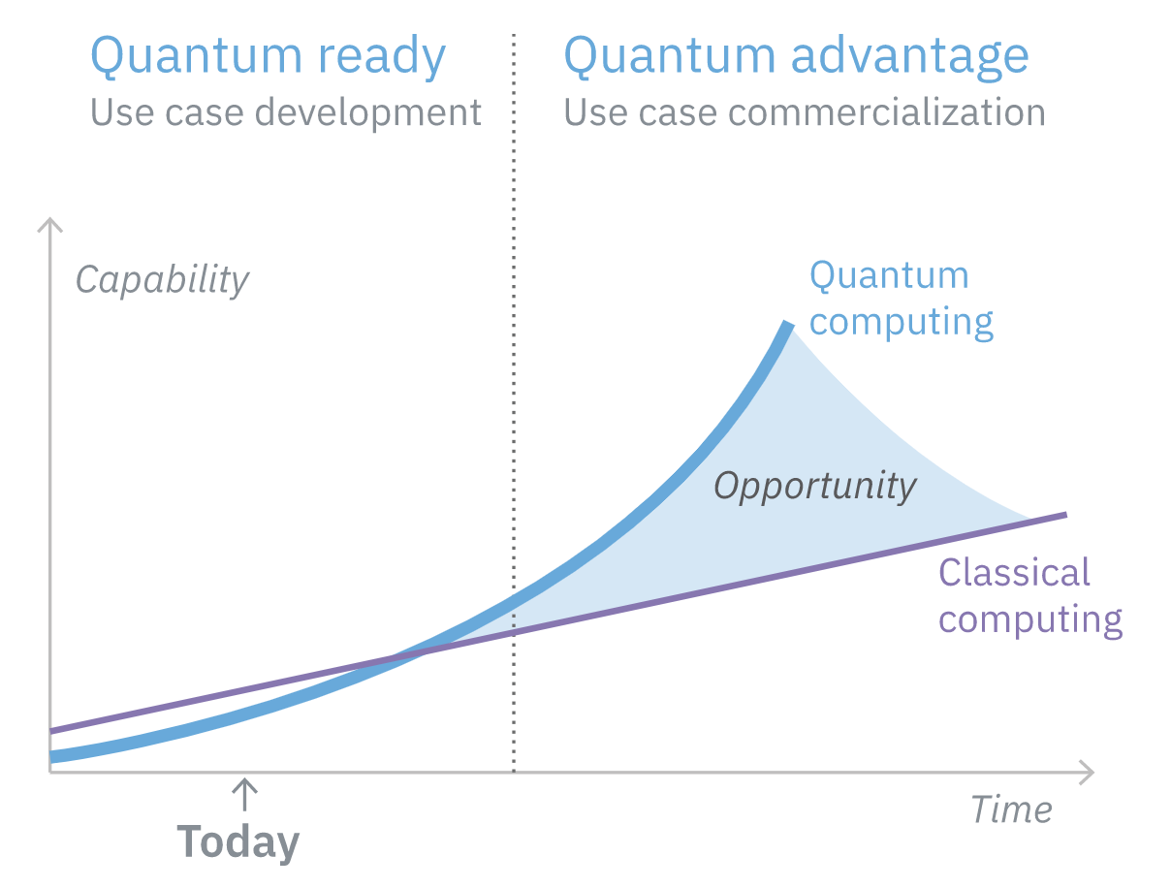
Quantum Computing and Classical Computing
Current NISQ QC:
Quantum Algorithms are not yet
as developed as classical one
Qubit Decoherence – Error
Lack of QRAM
➔ Need:
HPC+QC Hybrid model
Heterogeneous workflow
Coming Soon Your Business: Quantum Computing
IBM: https://www.ibm.com/thought-leadership/institute-business-value/en-us/report/quantumstrategy

Slide 13
Integration of HPC and QC
At a system level – QC integrated in HPC clusters
At a programming level – Build a full hardware-software stack
At an application level – QC leads disruptive changes in the complexity of some applications
➔Thus, compute-intensive, or intractable problems in the HPC domain ➔ Tractable in QC

Slide 14
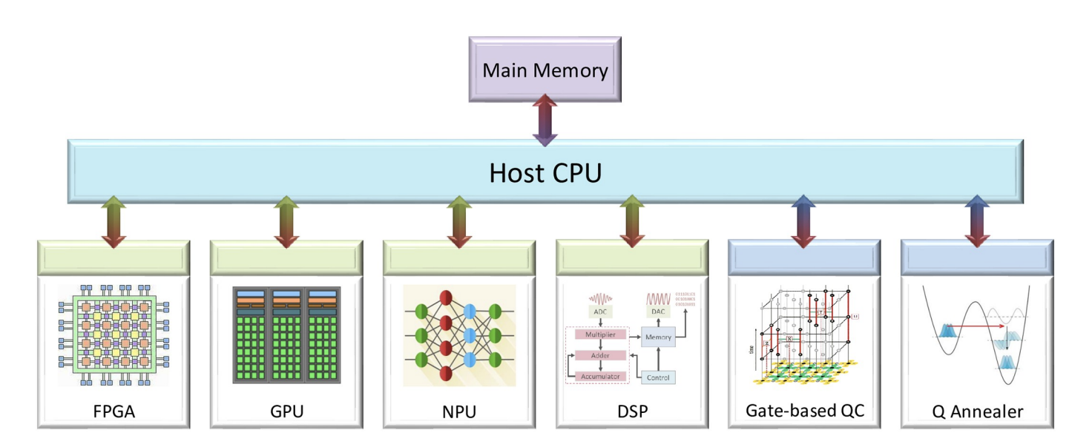
Hybrid Architectures: The Accelerator Models of Computing
The Accelerator models of computing
(Sakar, Al-Ars, and Bertels 2021, PLoS ONE 16, 4: e0249850)

Slide 15
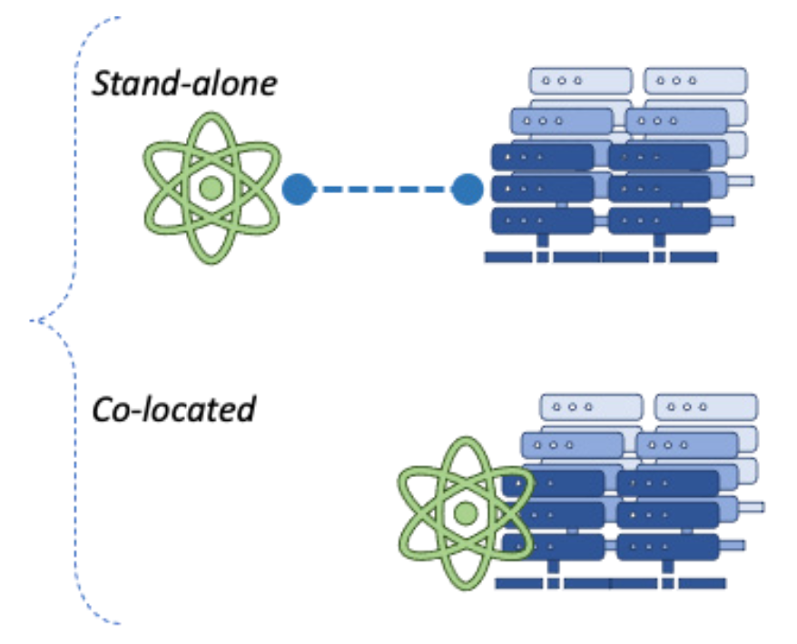
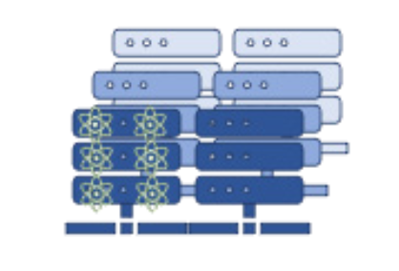
System Integration with Quantum
Loose integration model:
Tight integration model:
On-chip QPU
T. Humble and K. Britt 2016, Software systems for High-performance Quantum Computing
K. Britt and T. Humble 2017, High-Performance Computing with Quantum Processing Units
K. Britt, F. Mohiyaddin, and T. Humble 2017, Quantum Accelerators for HPC Systems
V. Bartsch, et. al. 2021, Quantum for HPC

Slide 16
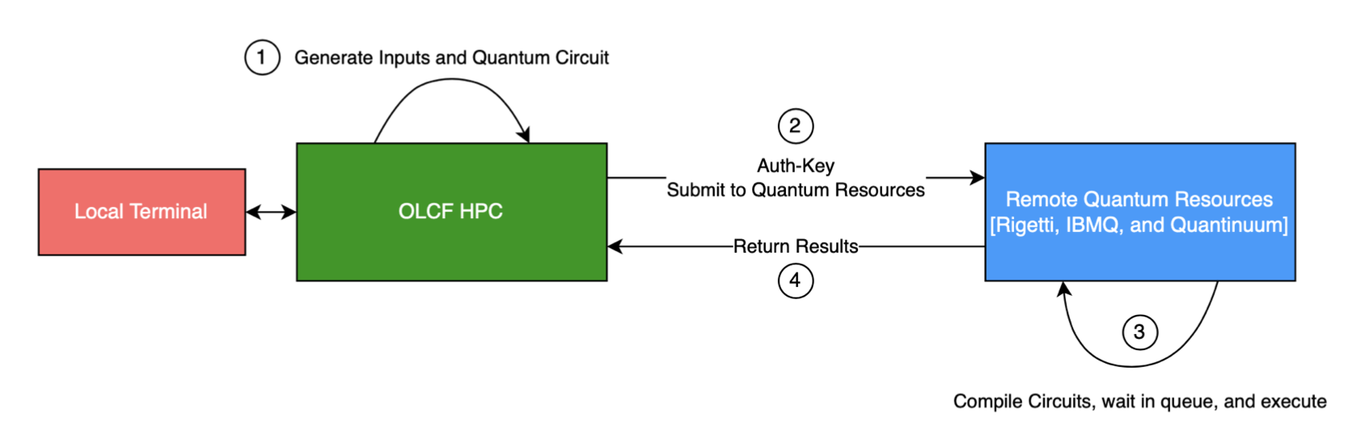
Workflows between HPC and Quantum Devices
Workflows between HPC and Quantum Computers, Bieberich, et al. (ORNL), 2022

Slide 17
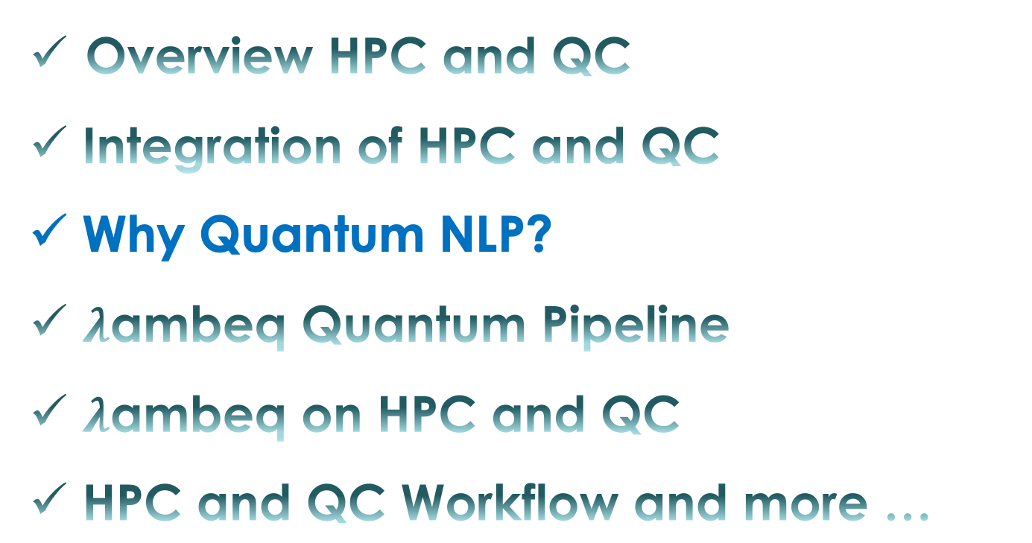
Contents
Overview HPC and QC
Integration of HPC and QC
Why Quantum NLP?
$λ$ambeq Quantum Pipeline
$λ$ambeq on HPC and QC
HPC and QC Workflow and more …

Slide 18
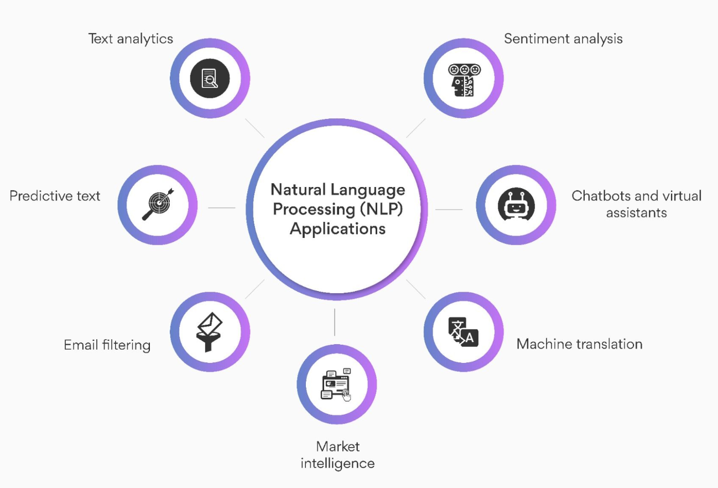
Natural Language Processing (NLP)
An area of study with elements from linguistics, computer science and artificial intelligence that focuses on the interaction between computers and human languages
The goal is to make computers capable of understanding text and spoken language in much the same way that human do
https://www.turing.com/kb/applications-of-quantum-nlp-for-translation

Slide 19
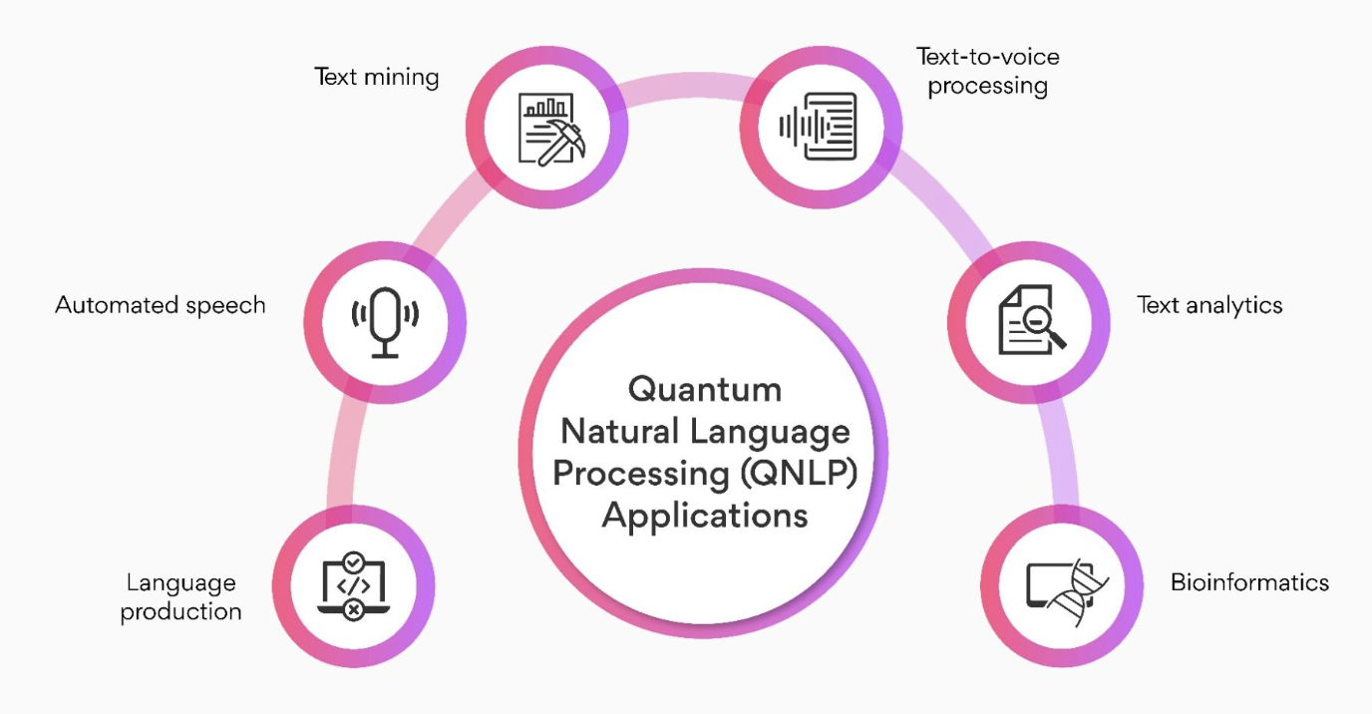
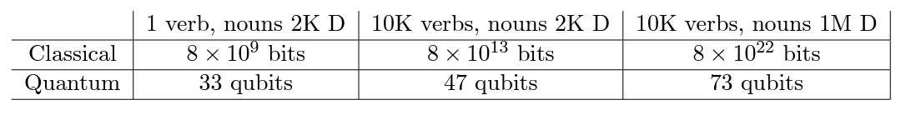
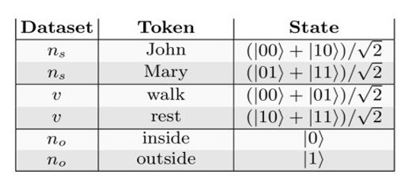
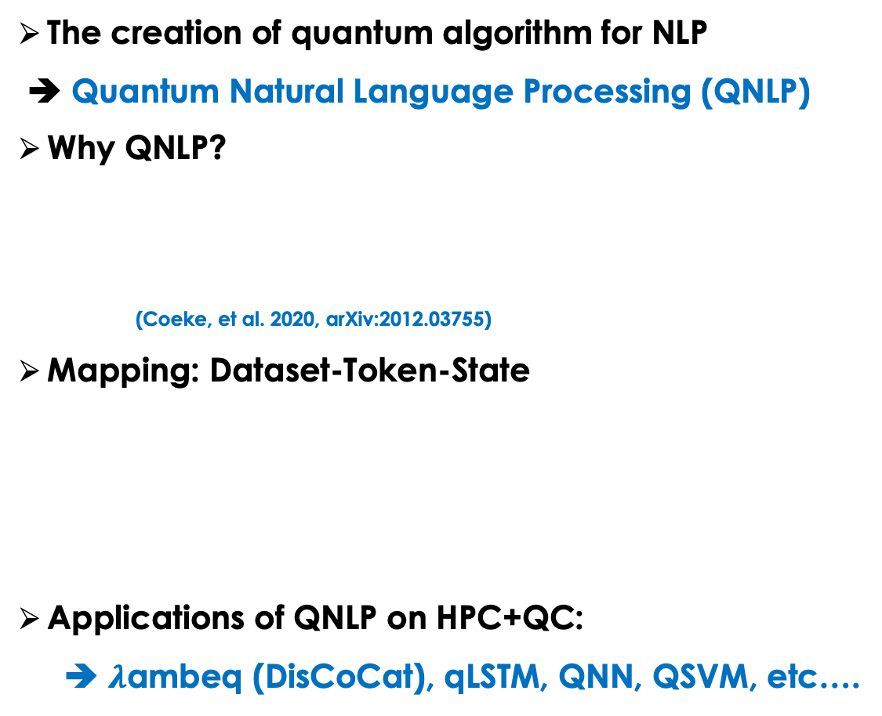
Quantum Natural Language Processing (QNLP)
The creation of quantum algorithm for NLP
➔ Quantum Natural Language Processing (QNLP)
Why QNLP?
(Coeke, et al. 2020, arXiv:2012.03755)
Mapping: Dataset-Token-State
Applications of QNLP on HPC+QC:
➔ $λ$ambeq (DisCoCat), qLSTM, QNN, QSVM, etc….
(O’Riordan, 2020 ML: Science and Technology, 2(1))
https://www.turing.com/kb/applications-of-quantum-nlp-for-translation
DisCoCat - Distributional Compositional Categorical

Slide 20
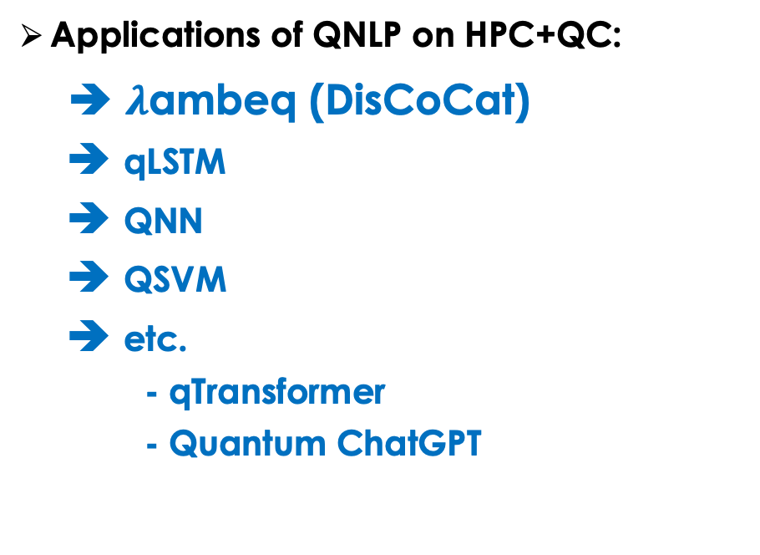
Quantum Natural Language Processing (QNLP)
Applications of QNLP on HPC+QC:
➔ $λ$ambeq (DisCoCat)
➔ qLSTM
➔ QNN
➔ QSVM
➔ etc.
- qTransformer
- Quantum ChatGPT
https://www.turing.com/kb/applications-of-quantum-nlp-for-translation
DisCoCat - Distributional Compositional Categorical

Slide 21
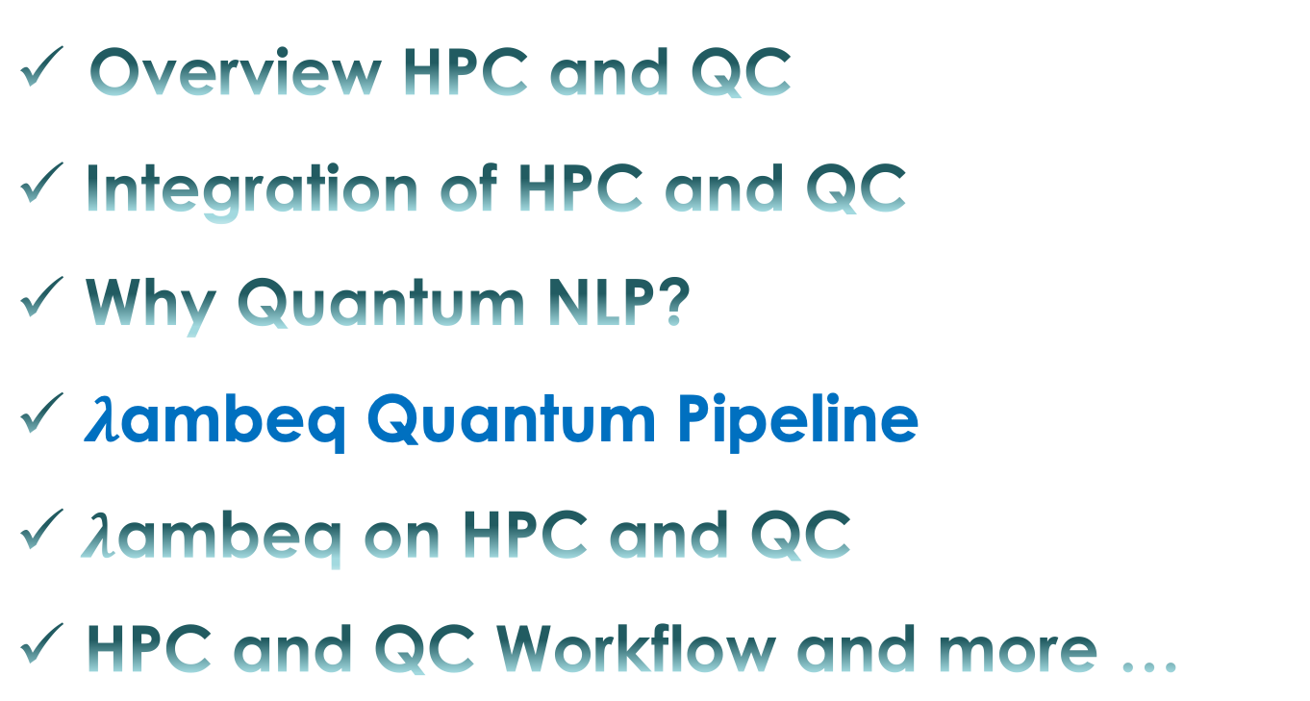
Contents
Overview HPC and QC
Integration of HPC and QC
Why Quantum NLP?
$λ$ambeq Quantum Pipeline
$λ$ambeq on HPC and QC
HPC and QC Workflow and more …

Slide 22
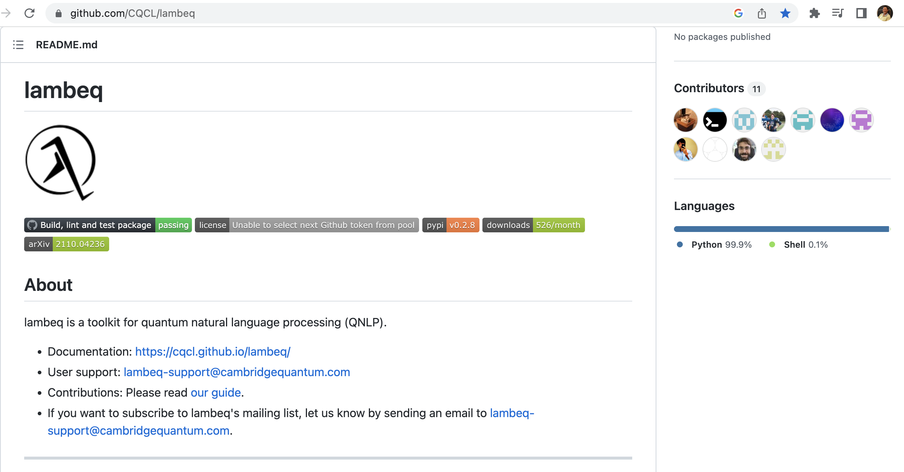

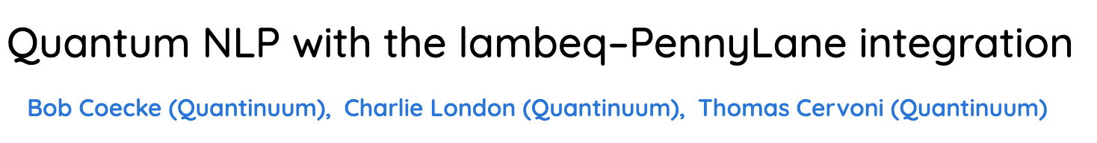
$λ$ambeq – a toolkit for QNLP (arXiv:2110.04236)
: An Efficient High-Level Python Library for Quantum NLP

Slide 23
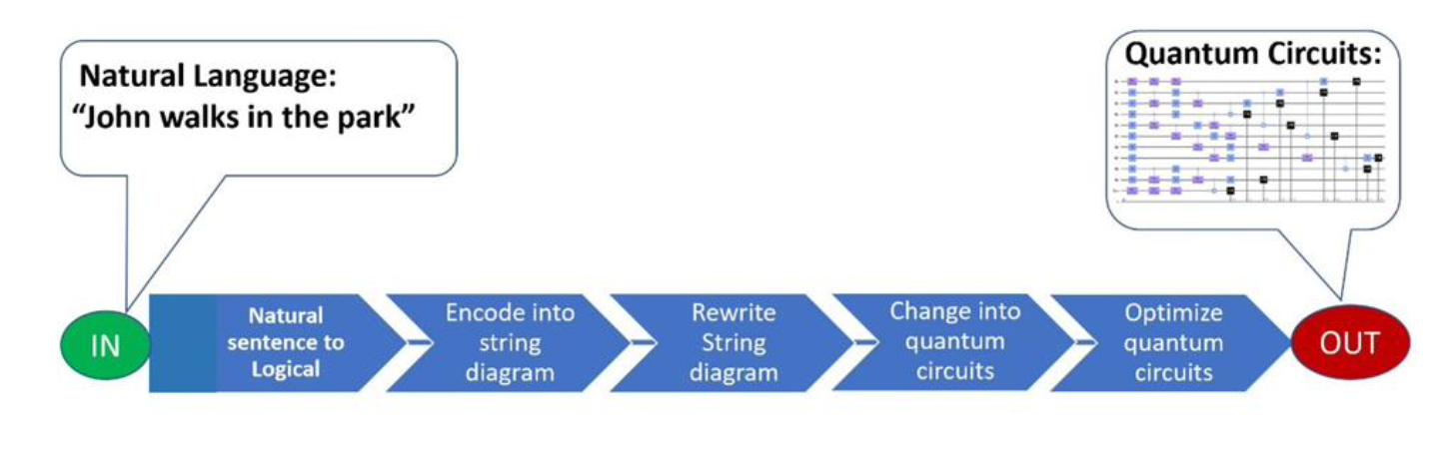
Lambeq (after the late mathematician and linguist Joachim Lambek)
The toolkit and Python library for QNLP
It works with TKET quantum software development platform
It automates tasks that are necessary for the large-scale implementation of QML pipelines designed in terms of compositional models of language
Lorenz, R. et at. (2021), arXiv:2102.12846

Slide 24
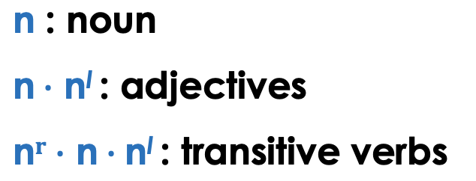
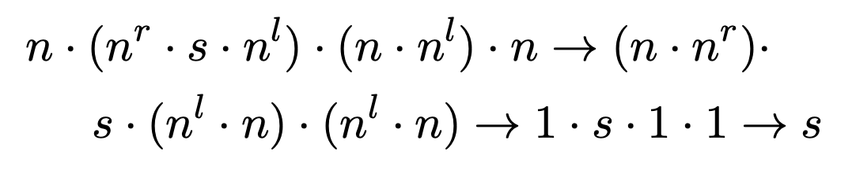

General Pipeline (Lorenz R. et. al., QNLP in Practice: arXiv:2102.12846)
Step 1: Syntax tree parse using Combinatory Categorial Grammar (CCG) parser
Step 2: Construct the sentences’ DisCoCat diagram
person prepares tasty dinner
DisCoCat - Distributional Compositional Categorical

Slide 25


General Pipeline
Step 3: Rewrite rules and remove cups (costly in quantum circuit)
→ Bending down all nouns
→ Reduced cups
Example of 5 words sentence

Slide 26

General Pipeline
Step 4: DisCoCat diagram is mapped to a quantum circuit
prepares
tasty
person
dinner
Cup = Bell-effect (CNOT)
(= tensor contraction)

Slide 27



Example
General Pipeline diagram
HPC
Lambeq
QC
HPC

Slide 28



Datasets
mc_dev_data.txt (30 lines)
MC (meaning classification) sentence data
by CFG (Context-Free Grammar)
mc_train_data.txt (70 lines)
mc_test_data.txt (30 lines)
0 - IT
1 - Food

Slide 29

Contents
Overview HPC and QC
Integration of HPC and QC
Why Quantum NLP?
$λ$ambeq Quantum Pipeline
$λ$ambeq Workflow on HPC and QC
HPC and QC Workflow and more …

Slide 30


Running on Jupyter Notebook

Slide 31




Slide 32




Quantum simulator/device
Post-processing

Slide 33


Running on Crusher and IBM Quantum
Quantum device
SLURM job script

Slide 34

Job submission to the Crusher compute node
Job monitoring on Crusher
Quantum pipeline
Classical pipeline

Slide 35



Job monitoring on IBM Quantum

Slide 36




Results
Classical pipeline (PyTorch backend of TN)
Classical simulation of quantum pipeline
(with SPSA optimization)
Noiseless simulation of quantum pipeline
Qiskit Aer
Noisy simulation of quantum pipeline
Qiskit Aer
arXiv:2110.04236 - Lambeq: An Efficient High-level Python Library for Quantum NLP

Slide 37

Contents
Overview HPC and QC
Integration of HPC and QC
Why Quantum NLP?
$λ$ambeq Quantum Pipeline
$λ$ambeq Workflow on HPC and QC
HPC and QC Workflow and more …

Slide 38




OLCF HPC - Quantum Workflow
Workflow
Management System
Job Type
# of qubit
Backend
Vendor
Scheduler
…..
$$💻$$
OLCF HPC
Workflow Management System
Qiskit Aer
NWQ-Sim
TN-QVM
QTensor
PennyLane
...
IBM
Rigetti
Quantinuum
IonQ

Slide 39

More from ORNL …

Slide 40
Thank you Questions?

